Slide 1

Automated Exam Scheduling
and Room Allocation System
CSE 211 Data Structures - Term Project (PROJ-16)
Team Members
Serkan Can Erdem
Mert Deha Karayel
Selin Yaslan

Slide 2
1. Project Overview
Problem Statement & Objectives
Key Features
Technologies & Tools Used
Automated conflict graph generation, heuristic time-slot coloring, capacity-aware bin packing, and responsive HTML timetable generation.
C++, strictly raw pointers (STL completely banned), JSON for data modeling, HTML/CSS for presentation, and Makefile for the build system.
University exam scheduling suffers from time conflicts and inefficient room capacities. The objective is to achieve a zero-conflict schedule with optimal room allocation.

Slide 3






2. System Architecture
JSON Parsing
In-Memory Objects
Conflict Graph Detection
Graph Coloring (Time Slots)
Bin Packing (Room Allocation)
HTML Output
Divided into core (Parser, Graph, Scheduler) and data_structures (DynamicArray, HashMap, LinkedList) to ensure strict modularity.

Slide 4
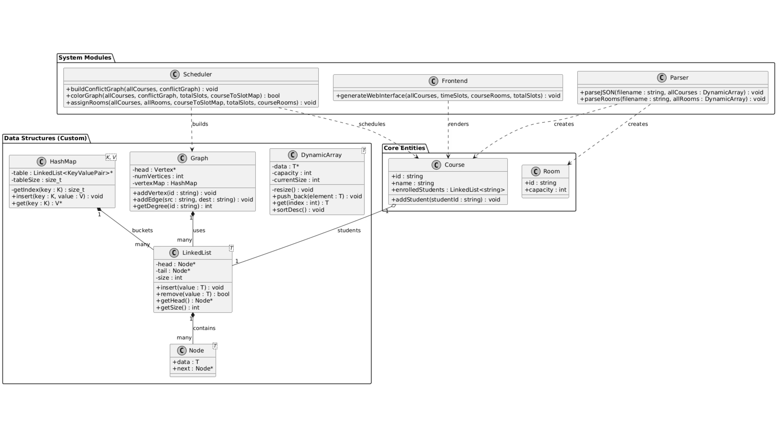

Slide 5
3. Data Structures (Part 1 - Implementations)
Custom Data Structures Implemented:
DynamicArray, LinkedList, and HashMap.
Why Each Was Chosen:
DynamicArray
LinkedList
HashMap
Chosen to replace std::vector to provide contiguous memory and O(1) amortized insertion.
Handles chaining in hash maps perfectly with O(1) head insertion, preventing memory fragmentation.
Replaces std::map. Chosen over tree structures for O(1) average-case key lookups (e.g., finding Course IDs).

Slide 6
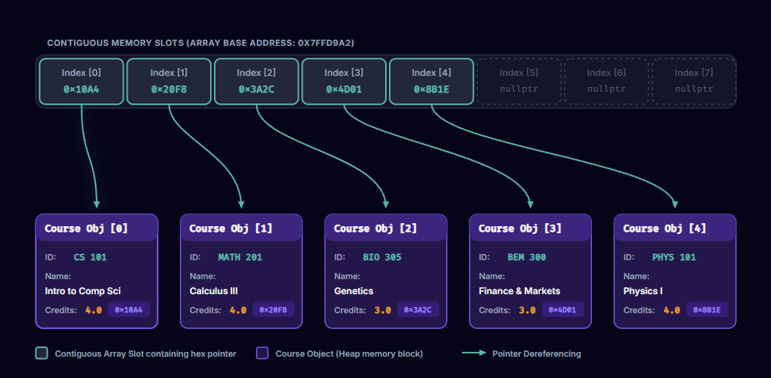
3. Custom DynamicArray Implementation
An index-based contiguous block of memory holding pointers (Course*). By storing pointers instead of raw structures, we keep cell sizes uniform, allow instant index calculations, and defer actual heap allocation of the heavy Course structures.

Slide 7
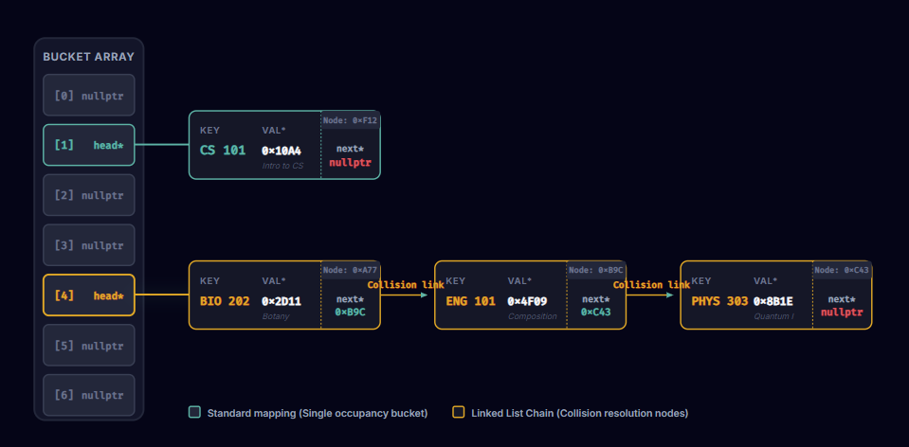
3. Custom HashMap with LinkedList Chaining
To resolve hash collisions manually, we implement separate chaining. The main table is an array of buckets, where each bucket holds a pointer to the head of a Singly LinkedList of key-value pair nodes (HashNode).

Slide 8
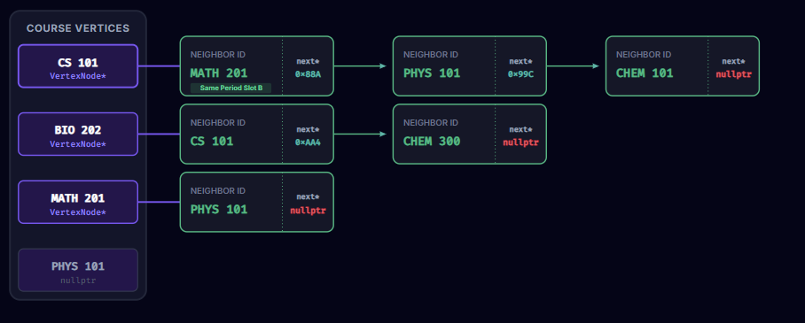
3. Custom Adjacency List Graph
This structure detects schedule overlaps. A Course Vertex maps to an internal Adjacency structure which maintains a singly-linked chain representing conflicts. It maps each Course ID to its directly conflicting neighbor Course IDs.

Slide 9
DATA STRUCTURES — PART 2
3. Data Structures (Part 2 - Graph & Complexity)
Custom Structure
Adjacency List Graph
Why Chosen
University course conflicts form a sparse graph. An Adjacency Matrix would waste massive memory. An Adjacency List reduces the footprint drastically.
Time and Space Complexity Analysis
Space Complexity of Graph:
O(V + E) where V is courses and E is conflict edges.
Space Complexity of HashMap:
O(B + N) where B is buckets and N is mapped nodes.

Slide 10
4. Module Implementation & Key Algorithms - Conflict Resolution
Core Function
1
Conflict Resolution
Key Algorithm
2
Welsh-Powell Graph Coloring Heuristic
Sorts courses by connection degree (descending) and assigns the lowest available, non-conflicting time slot (color).
Design Decision
3
Exact backtracking algorithms are too slow for large datasets. A greedy heuristic like Welsh-Powell provides excellent results in acceptable time.
Algorithm Complexity
4
O(V² + E)

Slide 11
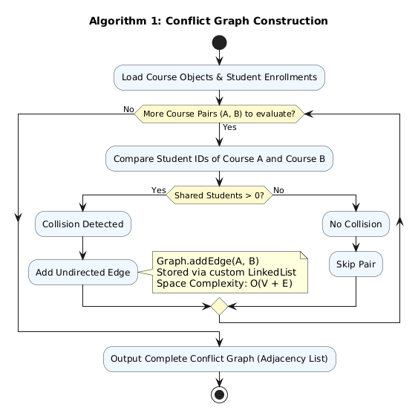
4. Conflict Graph Algorithm
The module constructs the core conflict network by performing a pairwise intersection scan across all course enrollments. If shared students are detected between any two courses, an undirected edge is established within our custom Adjacency List.
This sparse graph architecture efficiently maps all scheduling constraints while maintaining an optimal O(V + E) space complexity.

Slide 12
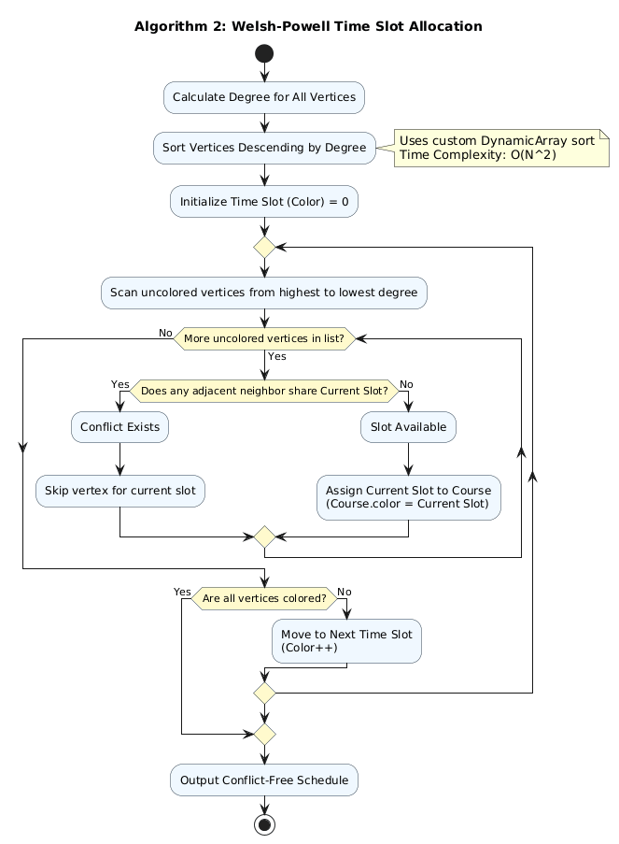
4. Graph Coloring Algorithm
To generate a conflict-free exam schedule, we implemented the Welsh-Powell heuristic. The algorithm first sorts all vertices by their conflict degree using our custom DynamicArray. It then sequentially assigns the earliest available time slot (color) to non-adjacent vertices. This greedy approach successfully resolves all overlaps while minimizing the total number of required exam sessions.

Slide 13
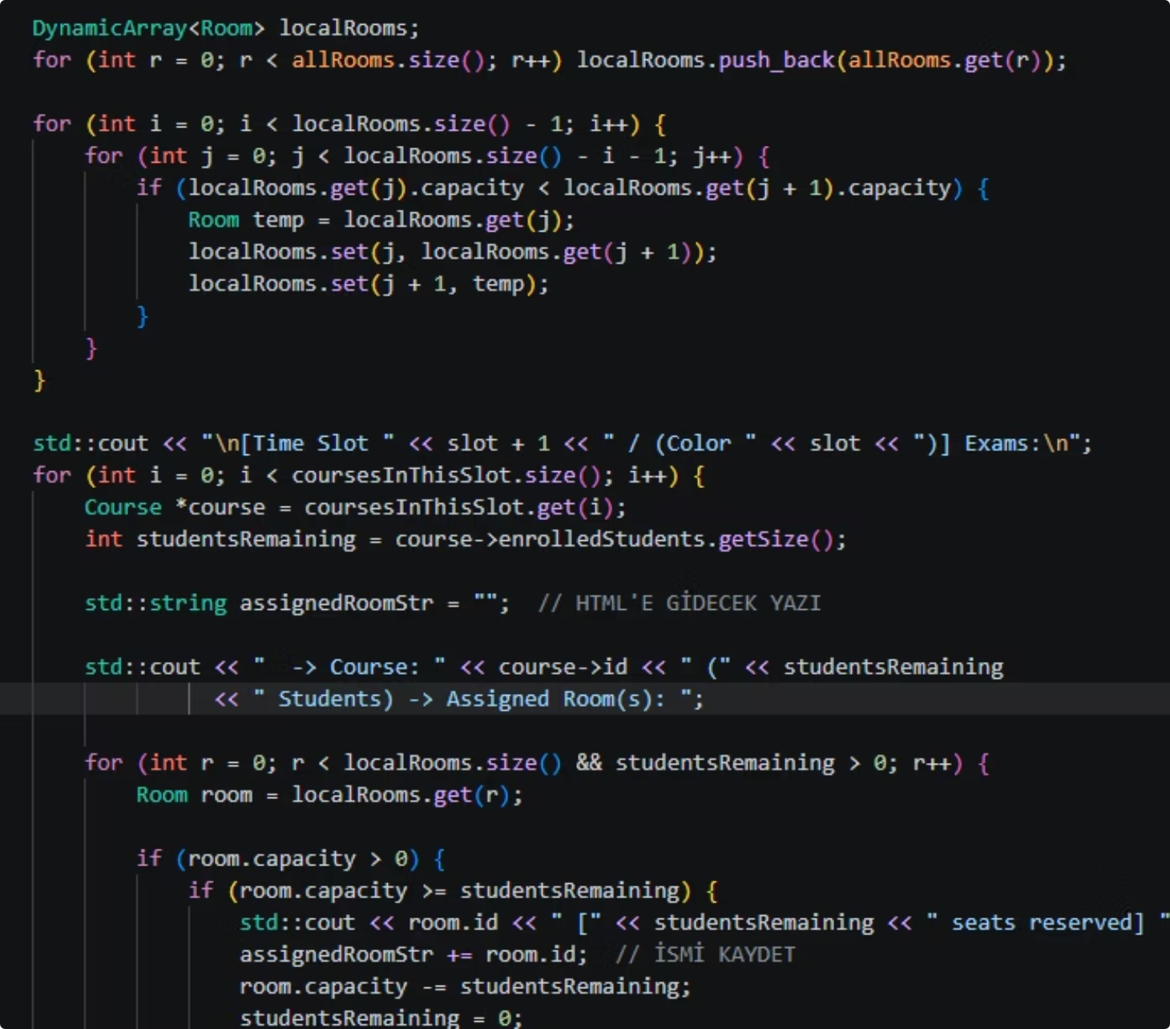
ROOM ALLOCATION
4. Module Implementation - Room Allocation
Core Function
Physical Classroom Assignment
Key Algorithm
First-Fit Decreasing (FFD) Bin Packing
Implementation Details
Sorts courses by student count and rooms by capacity. Places the largest student group into the first room that fits. If a single room isn't enough, it splits the course across multiple rooms.

Slide 14
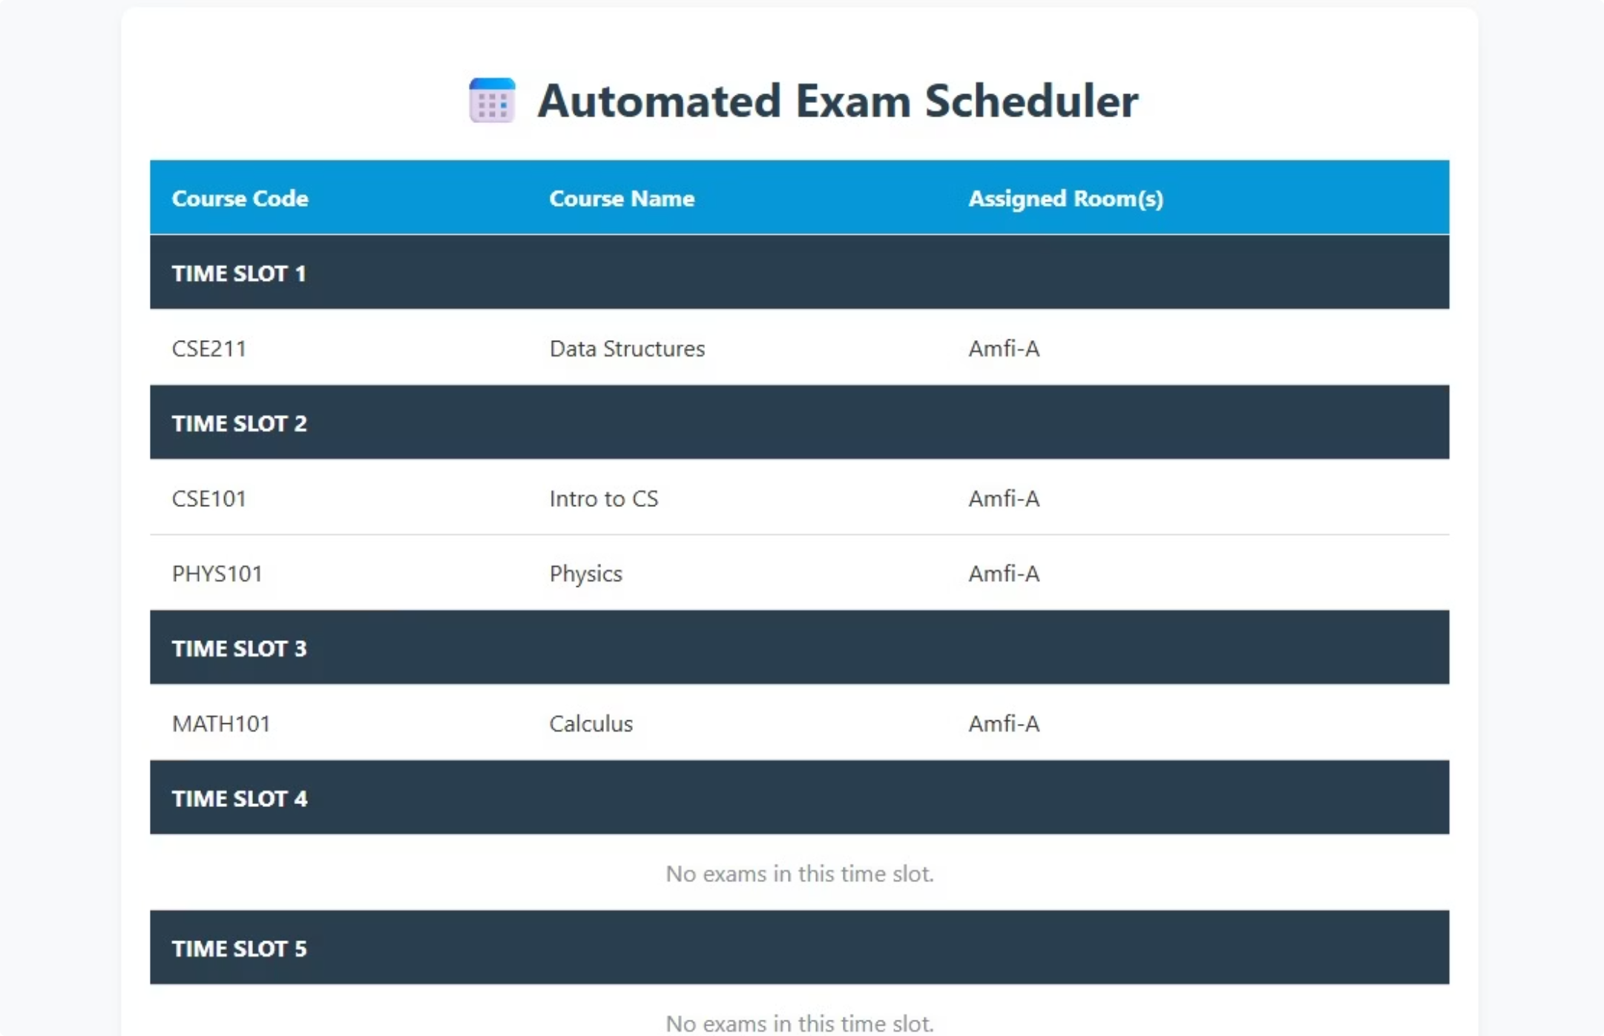
5. Frontend Implementation
UI Design
Responsive, color-coded HTML table separating days, time slots, and assigned rooms.
Integration with Backend
The C++ Frontend module directly parses the final scheduled arrays and writes raw HTML tags into exam_schedule.html. No external web servers are used.

Slide 15

6. Testing and Validation
Testing Strategy
Multi-layered approach using make test.
Unit Tests
Validating core mechanics of custom data structures.
Integration Tests
Ensuring the JSON → Graph → Output pipeline functions correctly.
Coverage Summary
Includes edge cases like "Room Saturation" (too many students, too few seats) and single-student enrollment handling.
Memory Leak Results
Zero memory leaks. Since smart pointers were banned, all new allocations were rigorously tracked and deleted in custom destructors.

Slide 16
7. Challenges and Solutions
Technical Challenges Encountered:
Implementing a collision-resistant HashMap without STL; managing multi-room splits without losing student counts.
How They Were Resolved:
Engineered custom Node structures for linked list chaining inside the hash map. Implemented strict capacity subtraction logic during bin packing.
Lessons Learned:
Deep understanding of manual memory management (new/delete), algorithm space complexities, and pointer manipulation without relying on standard libraries.

